Slide 1
You have 1 minute to write down as many
Comic Book Heroes that you know.
*Write your list on the post it note on your desk

Slide 2
Initiate a conversation with
your partner by asking them:
Do you consider reading
Comic Books “literature?”
You have up to 2 minutes to discuss.

Slide 3
The most recent Comic Book that has
been adapted into a movie is…

Slide 4
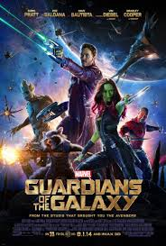
The most recent Comic Book that has
been adapted into a movie is…

Slide 5
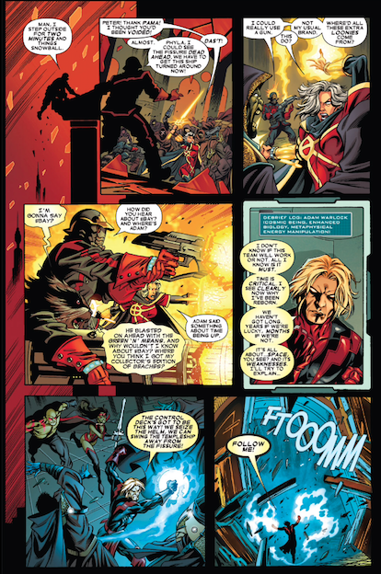
Think about how reading a page in a comic book differs from reading a page from a book.

Slide 6
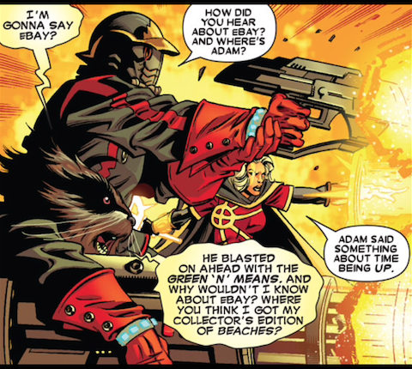
Which bubble do you read next?

Slide 7
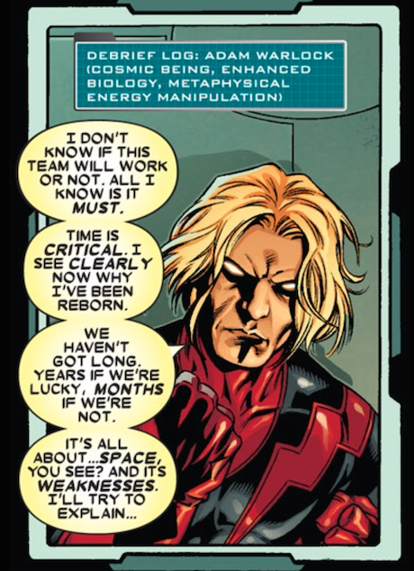

Slide 8
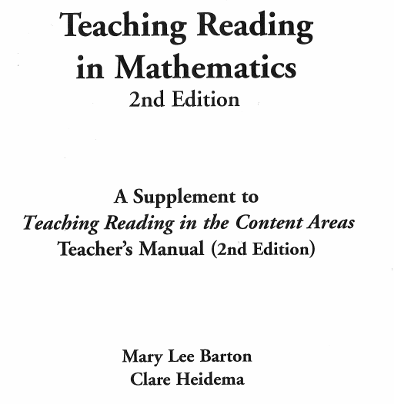

Slide 9
While Reading the Article…
Highlight key ideas that you think are important to the main idea of the text
Underline words or phrases that you are unfamiliar with
Write a one sentence summary of what the paragraph is saying.
(write summary on separate sheet of paper)

Slide 12
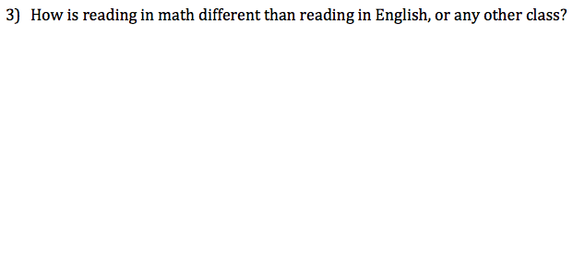

Slide 16
What is the picture telling you?
Directions: Decode the message shown by the picture below

Slide 17
What is the picture telling you?
Directions: Decode the message shown by the picture below

Slide 18
What is the picture telling you?
Directions: Decode the message shown by the picture below
“No Time Like
the Present.”

Slide 20
“There’s no time
to spare.”

Slide 22
“Roast
Beef
Sandwich”

Slide 23
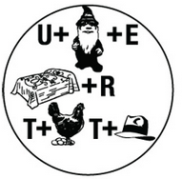

Slide 24
gnome
⬇

Slide 25
“You know me
better than that”

Slide 26
What does it mean to decode?

Slide 27
What does it mean to decode?
To convert (a coded message) into
intelligible language.

Slide 28
What does it mean to decode?
To convert (a coded message) into
intelligible language.
synonyms: decipher, decrypt, work out, solve, interpret, translate; make sense of, get to the bottom of,
unravel, unscramble, find the key to; figure out
"the enemy's battle plans were decoded"

Slide 29
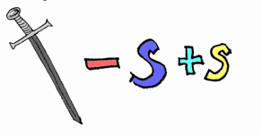

Slide 30
“Be Not a Slave to Words.”

Slide 31
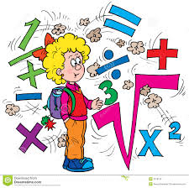
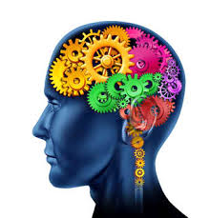

Slide 32
Quick Write (12 min.)
Prompt:
According to the article, why is it important to read in mathematics? Justify your answer with a quote from the text.

Slide 33
Reading in Mathematics is important because
____________________________ (claim).
The article states _____________________
_____________________________(evidence).
This is important so that in the future, I can ___
___________________________ (explanation).

Slide 34
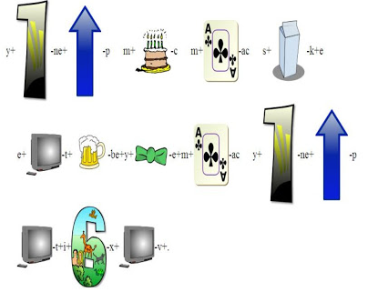

Slide 35
“You make me smile
every time you visit!”

