Slide 1
AP CALC – UNIT 6 STATION INSTRUCTIONS
Hello all and happy Monday (or Wednesday!)
The exam on Thursday will have two standards
- 23.0 Testing Series for Convergence
- 24.0 Finding a Series Interval of Convergence
Complete the practice on the following slides in your practice notebook.
Make sure to
1) Title the practice with the standard name
2) Copy the original practice problem
3) Set up appropriate convergence test
4) Carry out EACH STEP neatly
5) Check Answers (on WEEBLY → UNIT 6 REVIEW)
If you can need help getting started… If you finish a standard’s LVL2 practice…
Try the LVL 3 Practice
WEEBLY → UNIT 6 REVIEW WEEBLY → UNIT 6 REVIEW
See video example (COPY EXAMPLE!) Complete AP MC/FRQ Practice

Slide 2
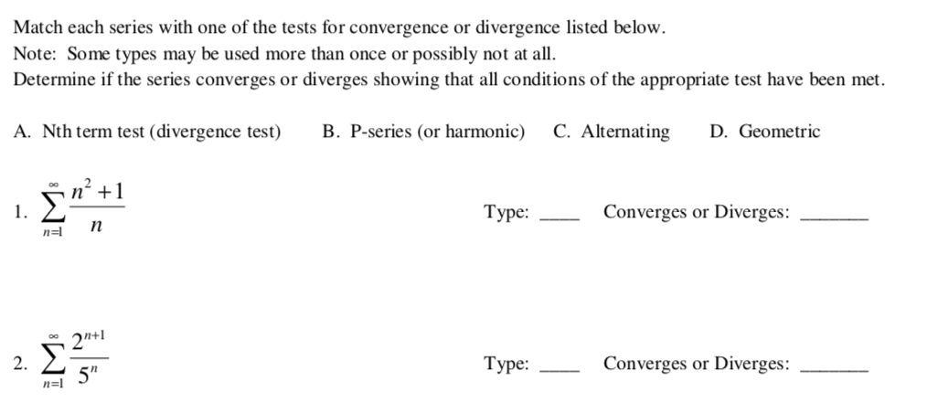
23.0 Testing Series for Convergence (LVL 1)
Continue on next slide

Slide 3
Continue on next slide

Slide 4
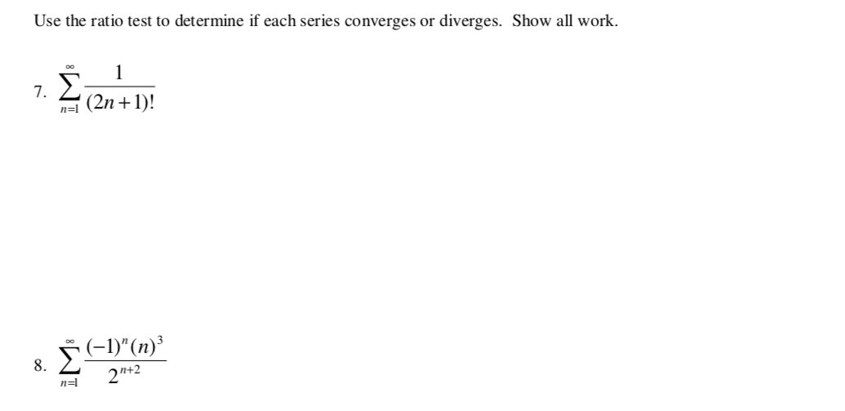
23.0 Testing Series for Convergence (LVL 2)

Slide 5
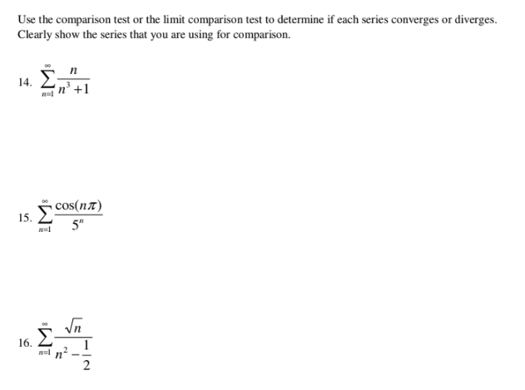
23.0 Testing Series for Convergence (LVL 2)

Slide 6
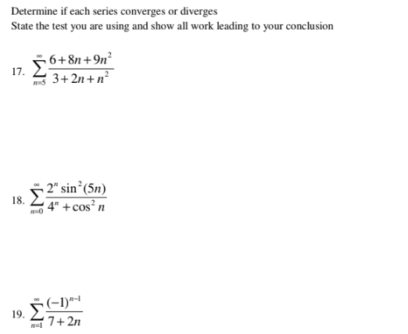
23.0 Testing Series for Convergence (LVL 3)

Slide 7
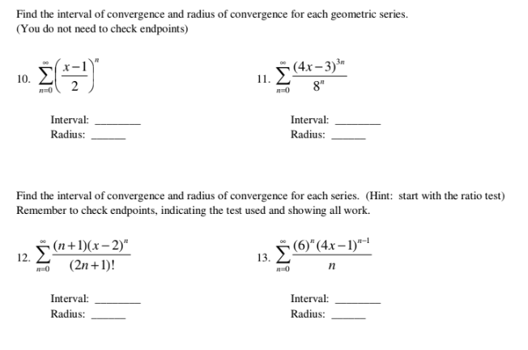
24.0 Finding Interval of Convergence

