Slide 1
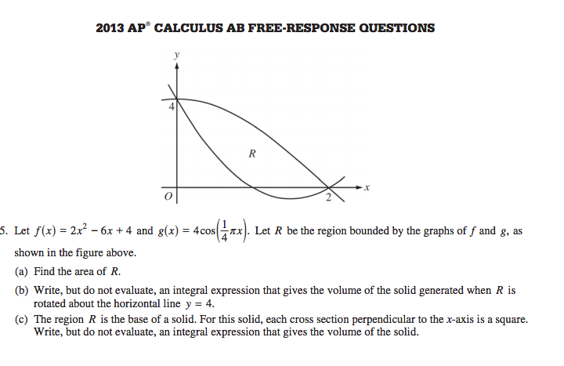
ACRAHS #16 Solis CALC
Name _____________________________ PER ________ DATE ___________
Complete the work for part A and BOX YOUR ANSWER. Then attempt to answer parts b and c OR ask a clarifying question and box it.
16.0

Slide 2
